Slide 1



Slide 2
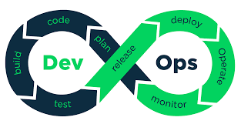

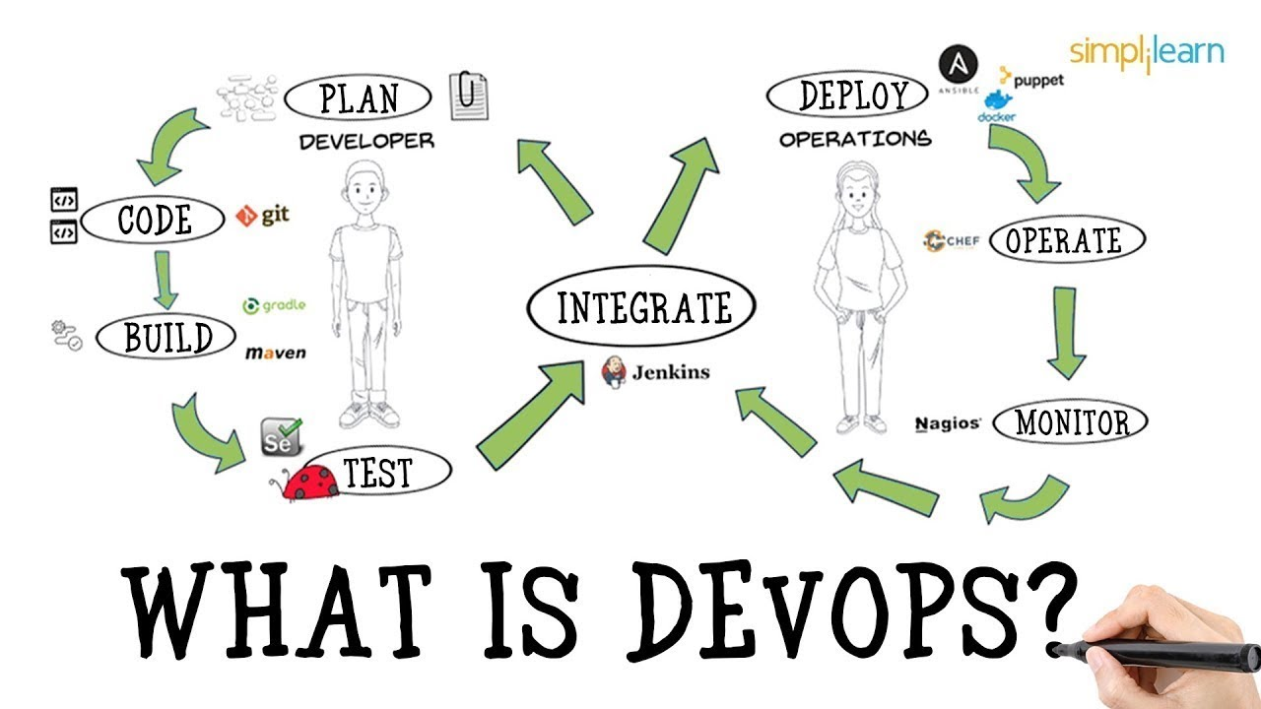

Slide 3
Now that you are in the DevOps family
What
is
Devops ?

Slide 4



DEFINITION
DevOps is the combination of two main words

Slide 5
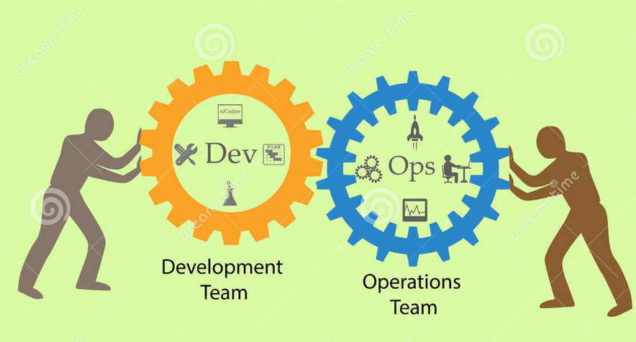
DEFINITION

Slide 6
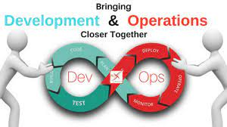
DEFINITION

Slide 7
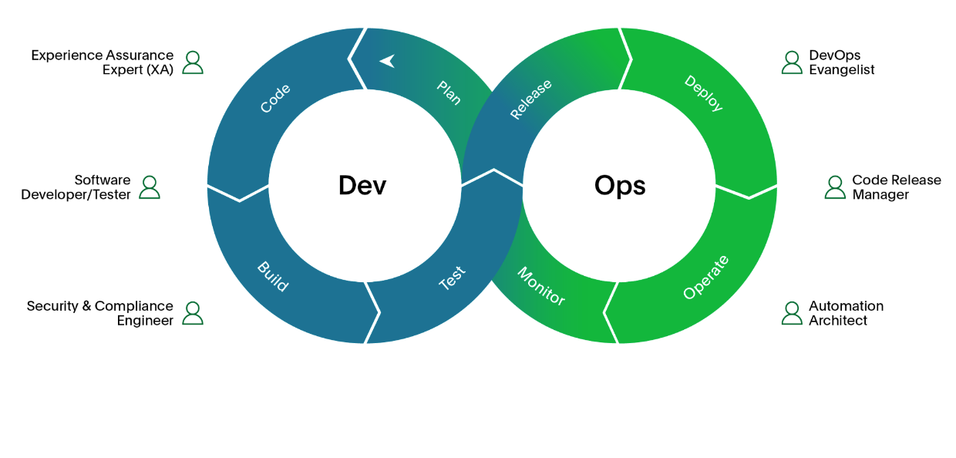
DEFINITION

Slide 8
DEFINITION
Let us talk about

Slide 9



DEFINITION
What is DEV ?

Slide 10

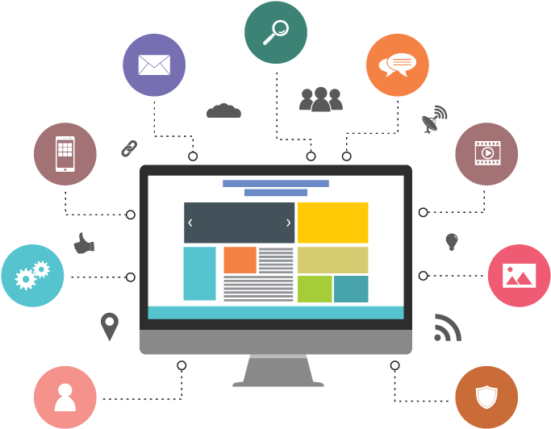

DEFINITION
Now that you know DEV is application development what is application?
Is a program, or set of programs, that allows end-users to perform particular functions.

Slide 11
DEFINITION
Big grammar aside
Are just tools we use daily to easy our life and solve issues, for example we use facebook, twitter, whatsapp to communicate or banking applications to monitor our bank accounts, or doordash to order food when we are hungry, or gmail, yahoo,msn, aol, outlook to check and monitor our email.

Slide 12
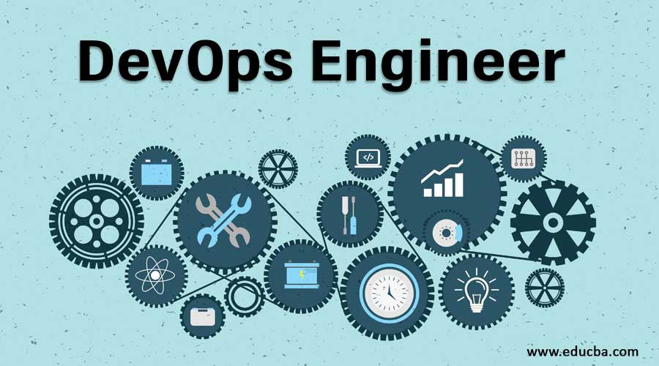

DEFINITION
Now that you know what is application and DEV
Has NOTHING to do with

Slide 13

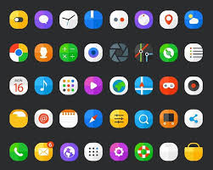

DEFINITION
develop

Slide 14

DEFINITION
In other words
Write application

Slide 15

DEFINITION
In other words
DO

Slide 16

DEFINITION
If Devops does not develop applications who does ?

Slide 17
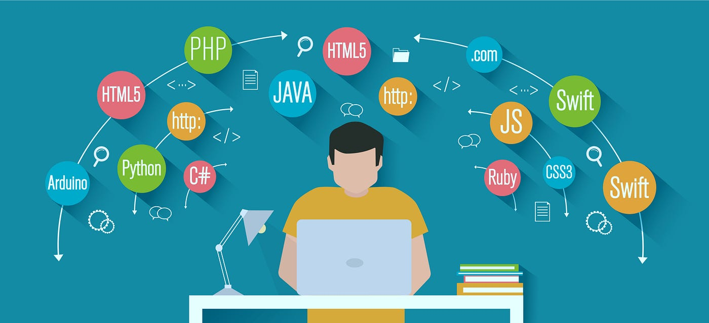
DEFINITION
Developers world

Slide 18

DEFINITION
Any question about

Slide 19
DEFINITION
Let us talk about

Slide 20

DEFINITION
What is OPS

Slide 21
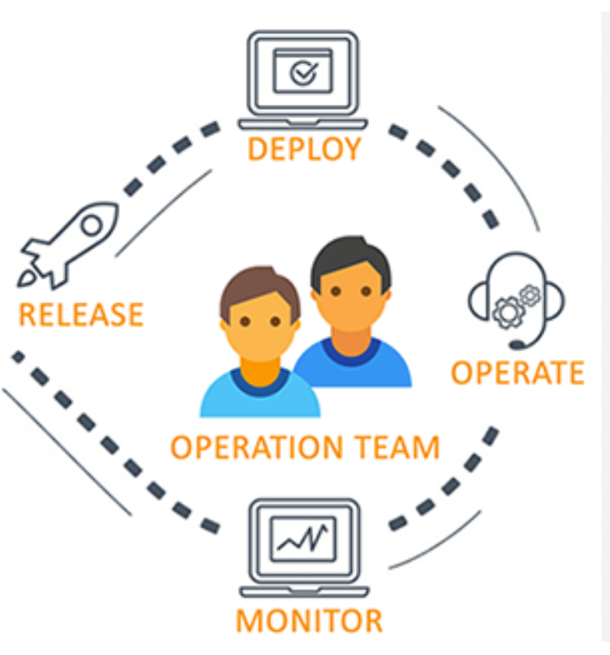
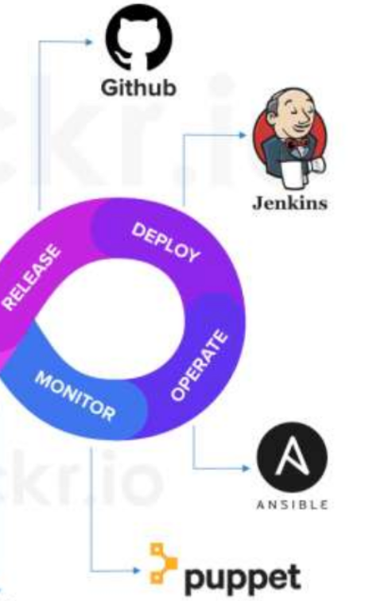
DEFINITION
What are Operations

Slide 22




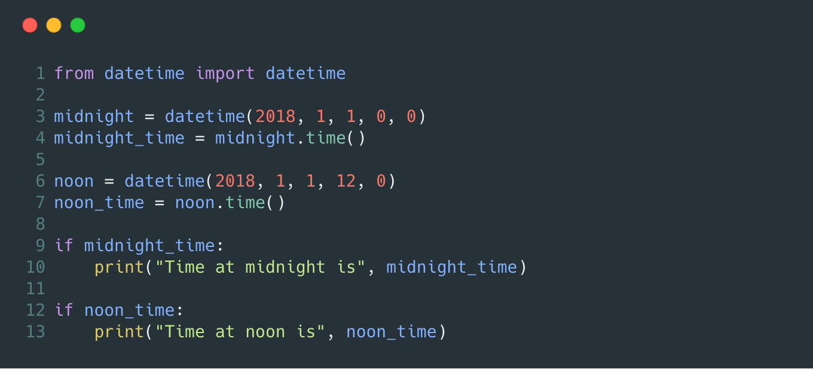
DEFINITION
What is Operation
In simple words operation in this context stand for transforming a code coming from developers into a working application

Slide 23
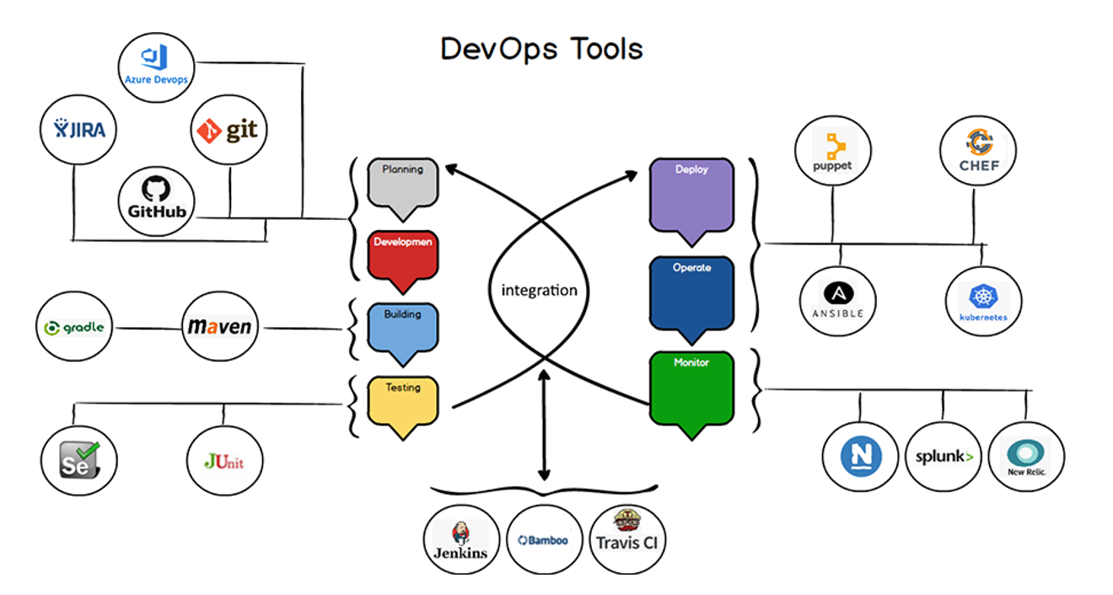
DEFINITION
DevOps engineer operation tools

Slide 24





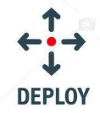


DevOps engineer operation process

Slide 25
Any question about

Slide 26
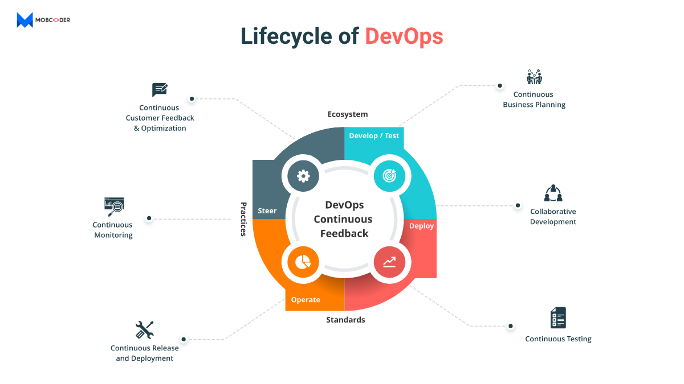
DevOps engineer operation process

Slide 27

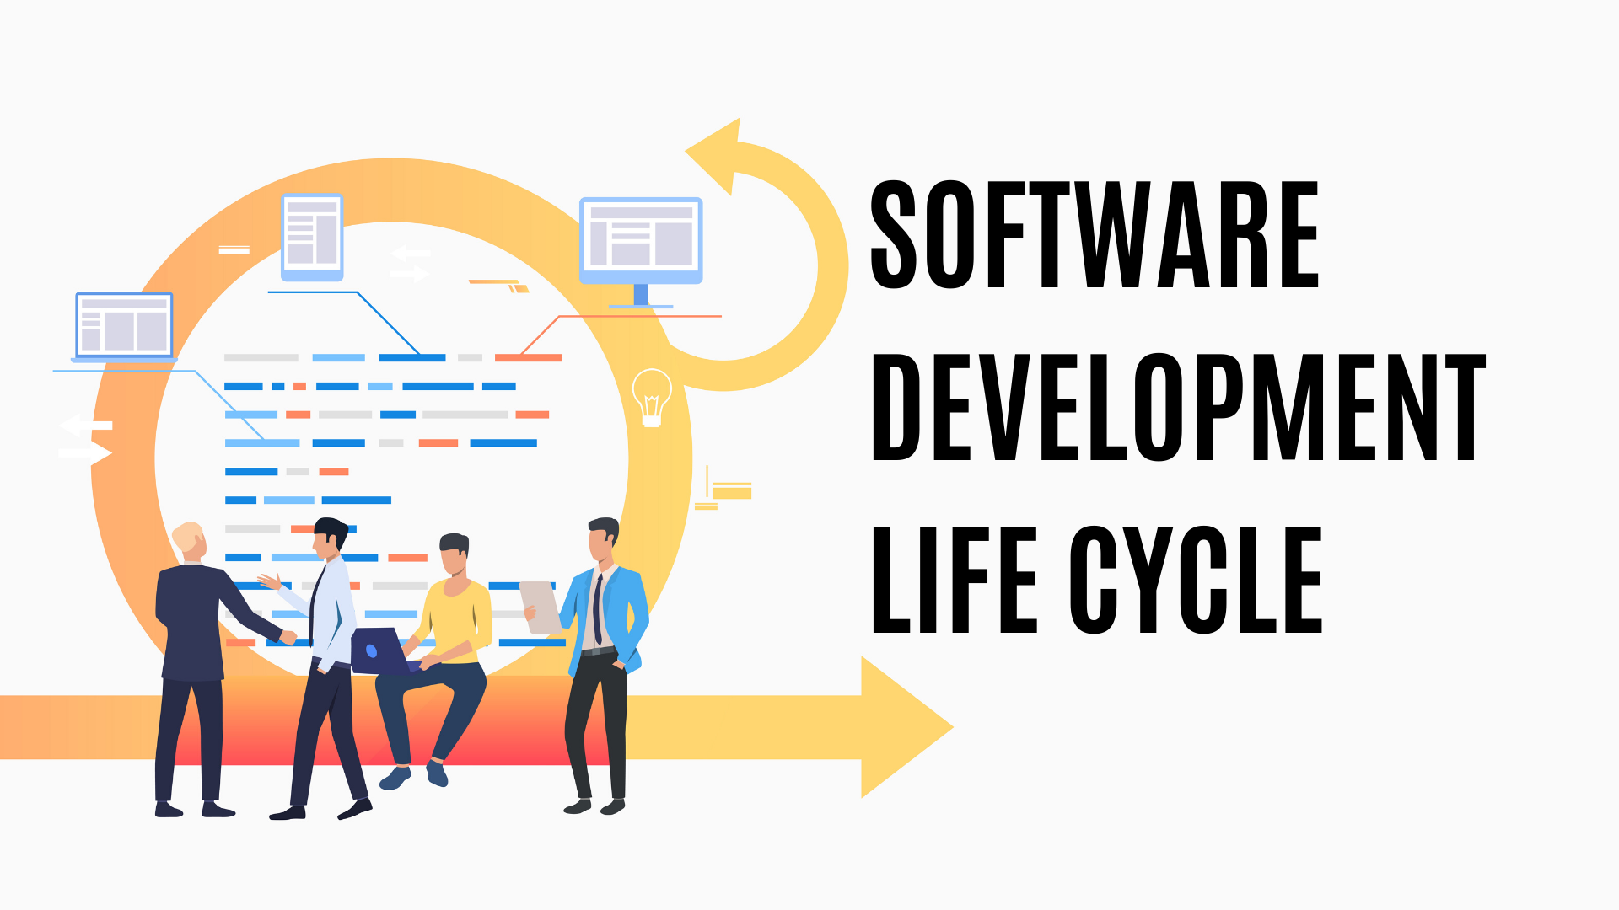
In other words
Write application code
Are more on the
Side of the

Slide 28

Give birth to

Slide 29

Now that you have an idea of what is

Slide 30
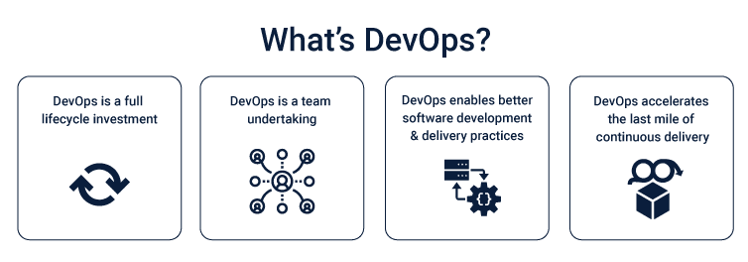

Slide 32
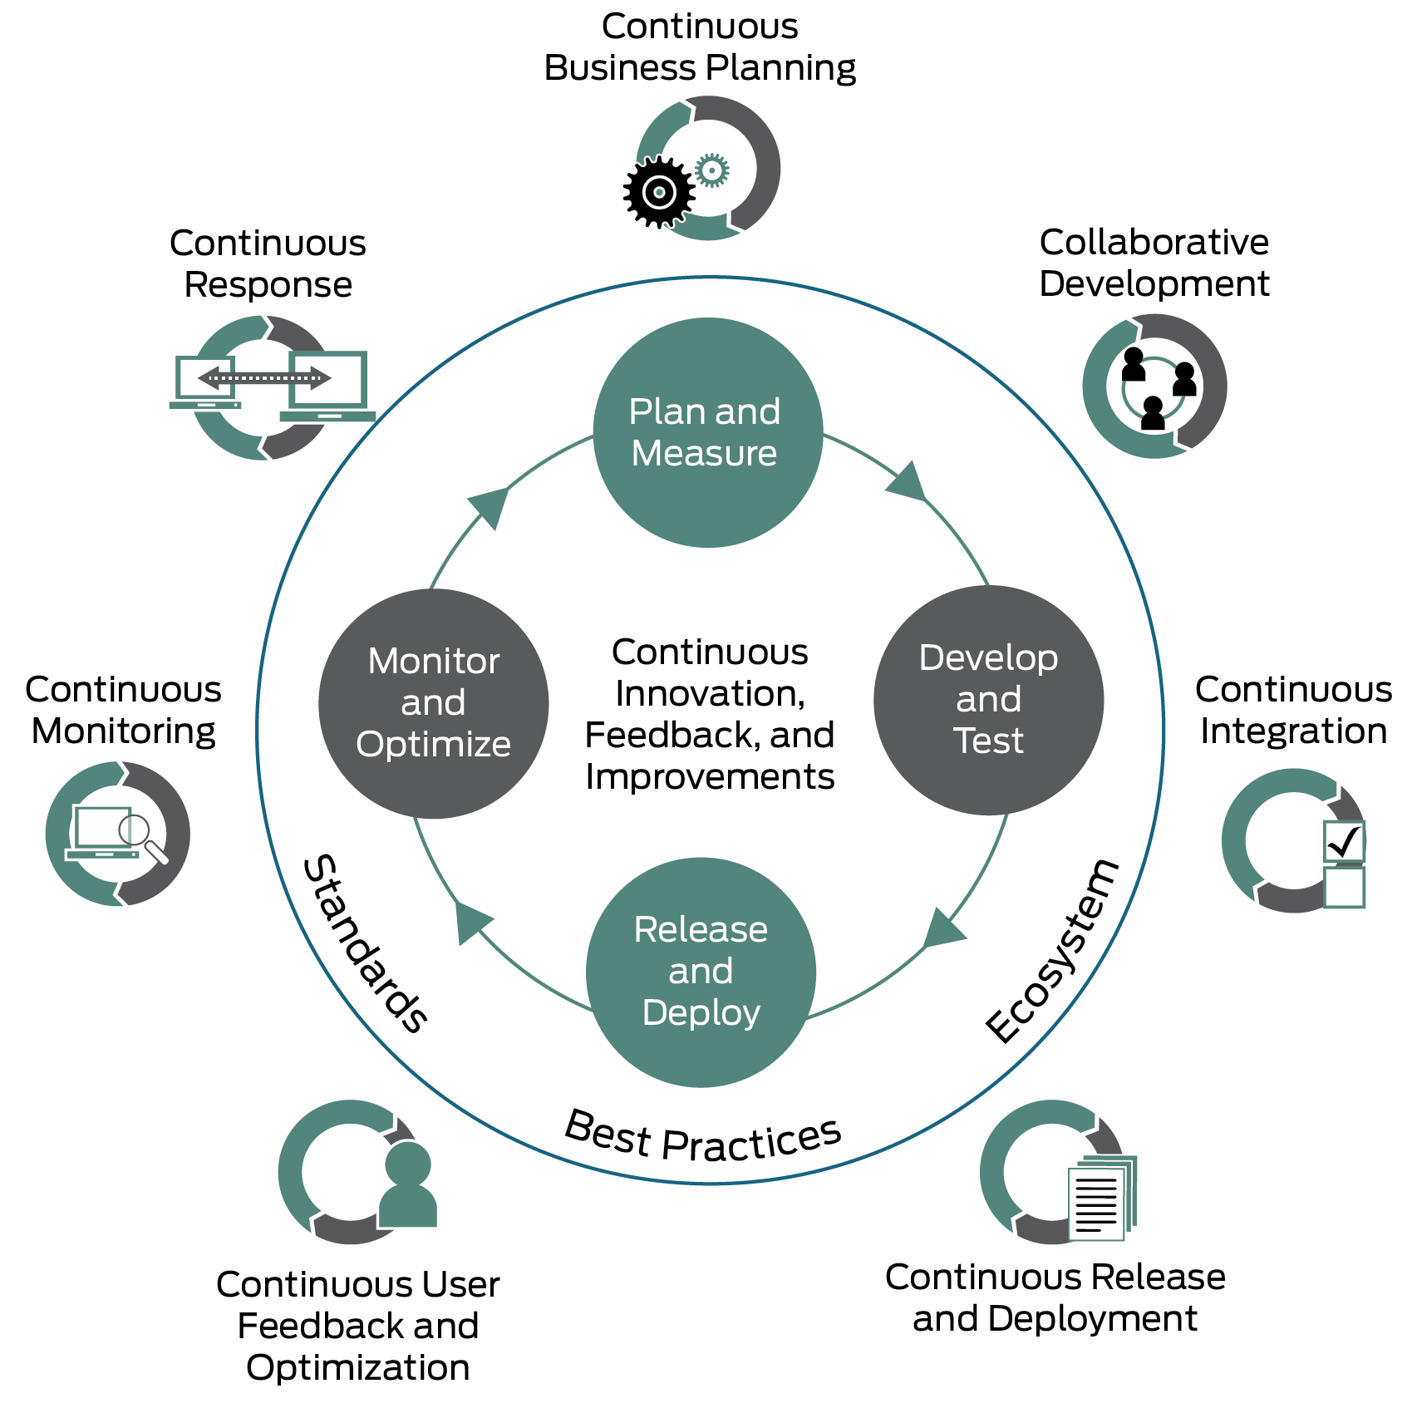

Slide 33
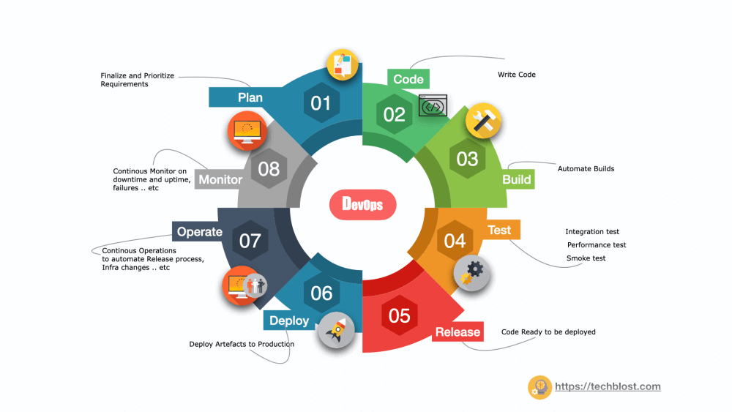

Slide 34
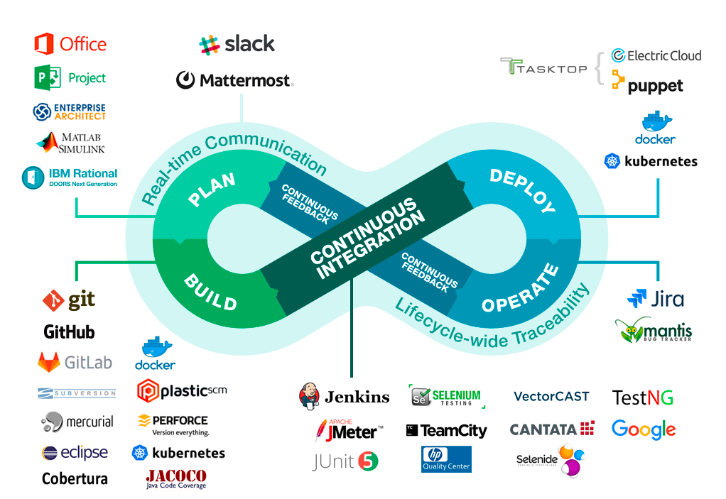

Slide 35

Tired of the big grammar ?

Slide 36

In simple worlds DevOps is a tradition or culture that help break the gap between
Development and operations teams to improve and better control the software
development life cycle (SDLC)

Slide 37
DevOps engineers are in middle of all software development life cycle (SDLC) teams and provide tools for those teams as well

Slide 38
Quality assurance
Team (QA)
Devops Security and Operations team
(DevSecOps)
Provide tools for
Development team (DEV)
Provide tools for
Provide tools for
Provide tools for
Security and Infosec
team
Provide tools for
Network Team (IT)

Slide 39


